Slide 1
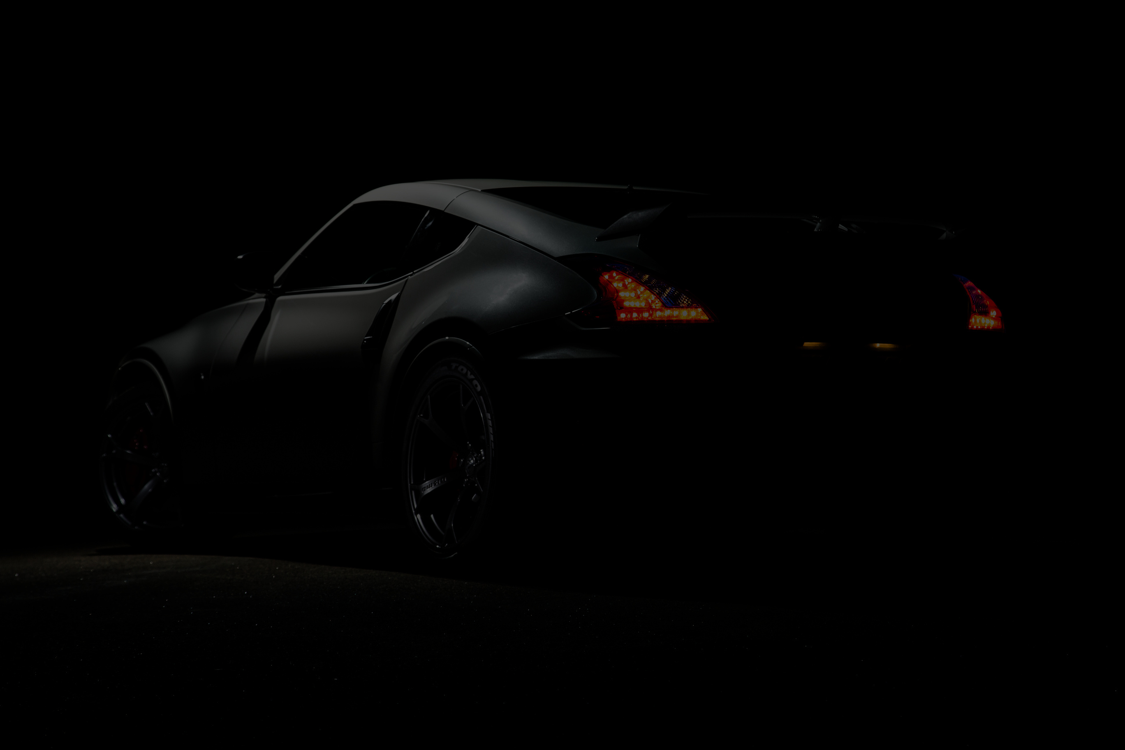


3BEGINNER’PRESENTATION
BORCELLE
Home
MALAYSIA DEALERSHIP
About
Contact
This website is an online store dedicated to selling detailed and collectible model cars. Here, customers can browse different types of model vehicles, add their favorites to the cart, and place orders easily. We also have an admin page where store owners can view customer orders and manage the store. Whether you're a collector or just love cars, our website makes it easy to find and order your perfect model car.
Get Started
Learn More
Play Video
2025 Presentation
Slide
1

Slide 2
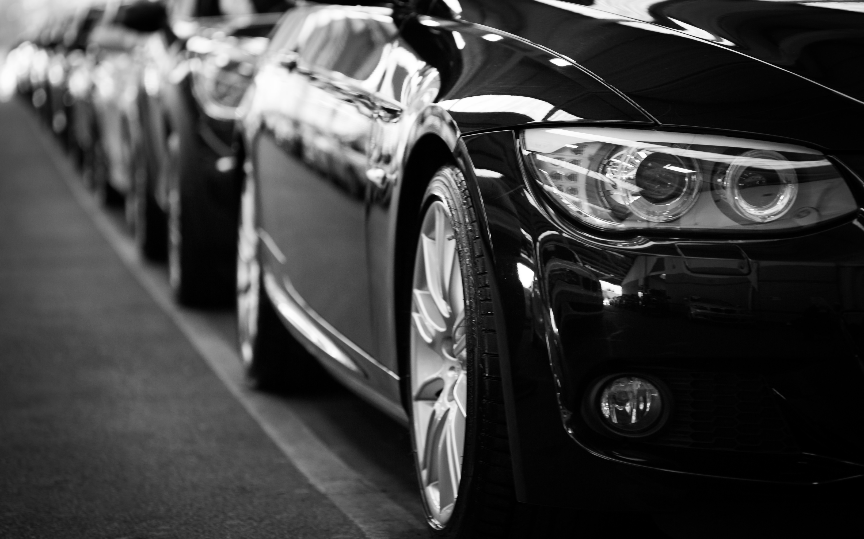
BORCELLE
Home
About
Contact
OUR MAIN OBJECTIVE
The main objective of this website is to create a simple, user-friendly online store for model car enthusiasts. It allows customers to easily explore products, add items to their cart, and place orders—while also giving the store owner a clear way to manage orders through an admin page.
Learn More
Slide
2

Slide 3
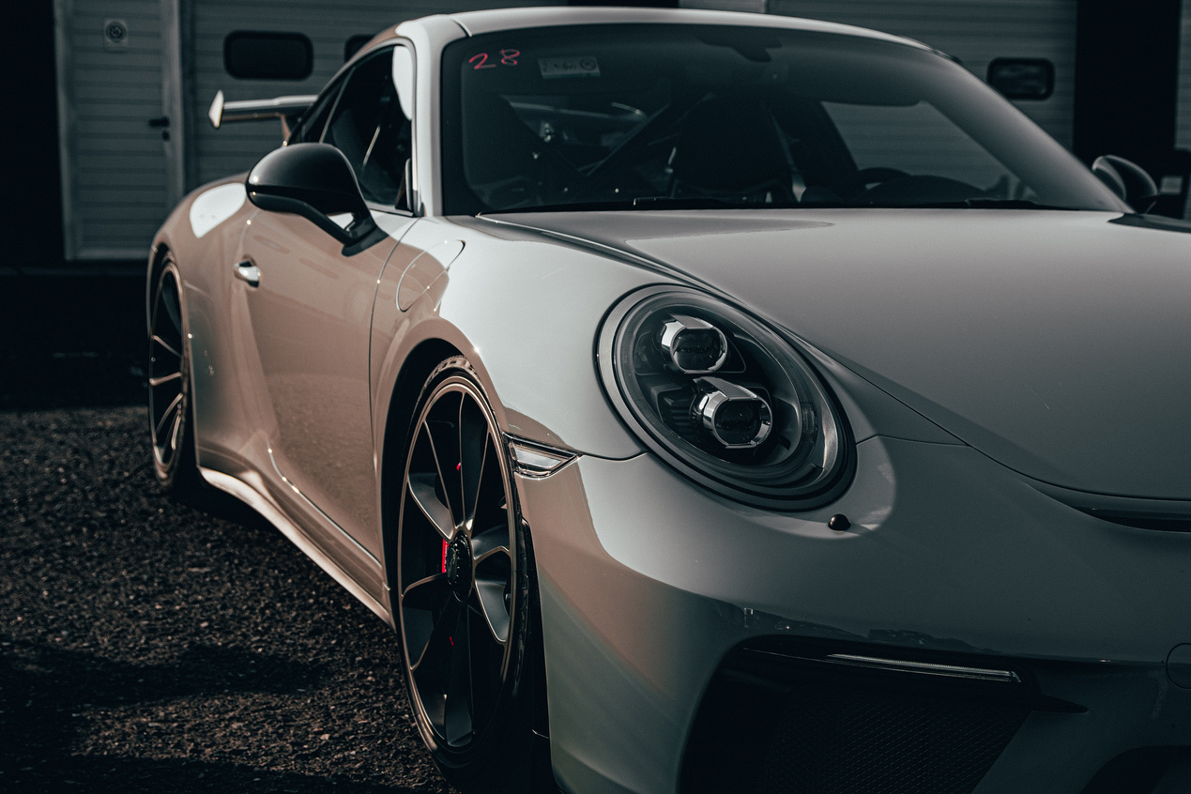
BORCELLE
Home
About
Contact
REASON BEHIND DESIGN
User-Friendly Interface
The design is kept simple and easy to navigate so that users—regardless of age or technical skill—can browse, shop, and place orders without confusion.
CONTENT CHOICES
Clear Product Information
Product names, images, and categories are presented clearly to help customers understand what they’re buying at a glance
Learn More
Slide
3

Slide 4
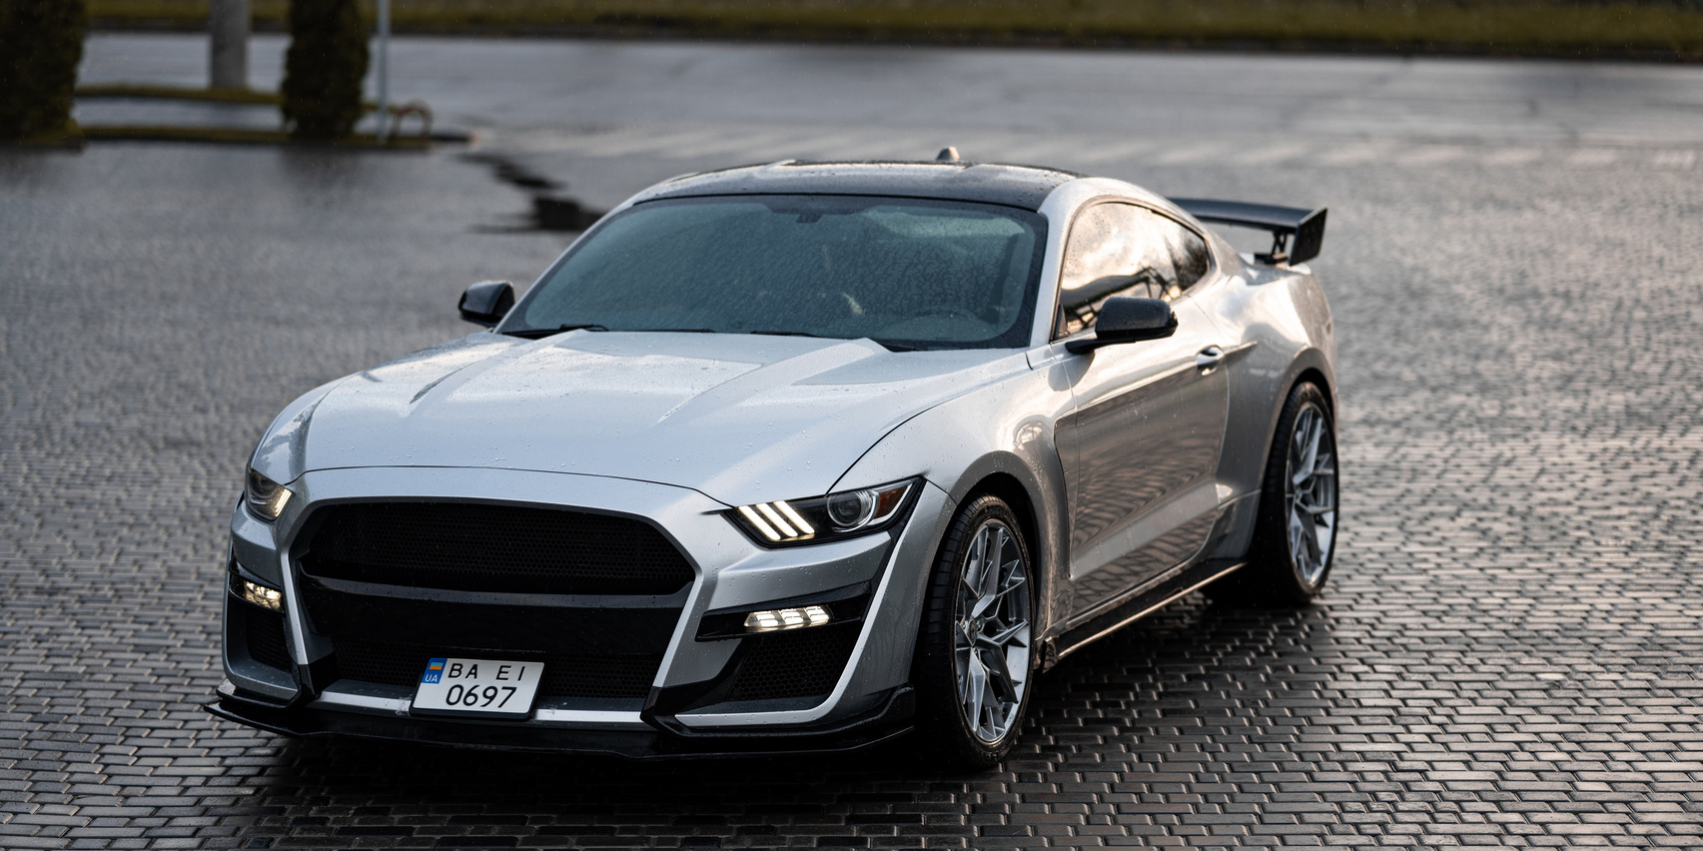
BORCELLE
Home
About
Contact
WHAT INSPIRED US AND MOTIVATED US
A Passion for Model Cars
I've always been fascinated by cars—especially miniature models that capture every detail.
Collecting and displaying model cars inspired me to turn my interest into a project.
This website brings that hobby into a digital space where others can share the same passion.
Learn More
Slide
4

Slide 5
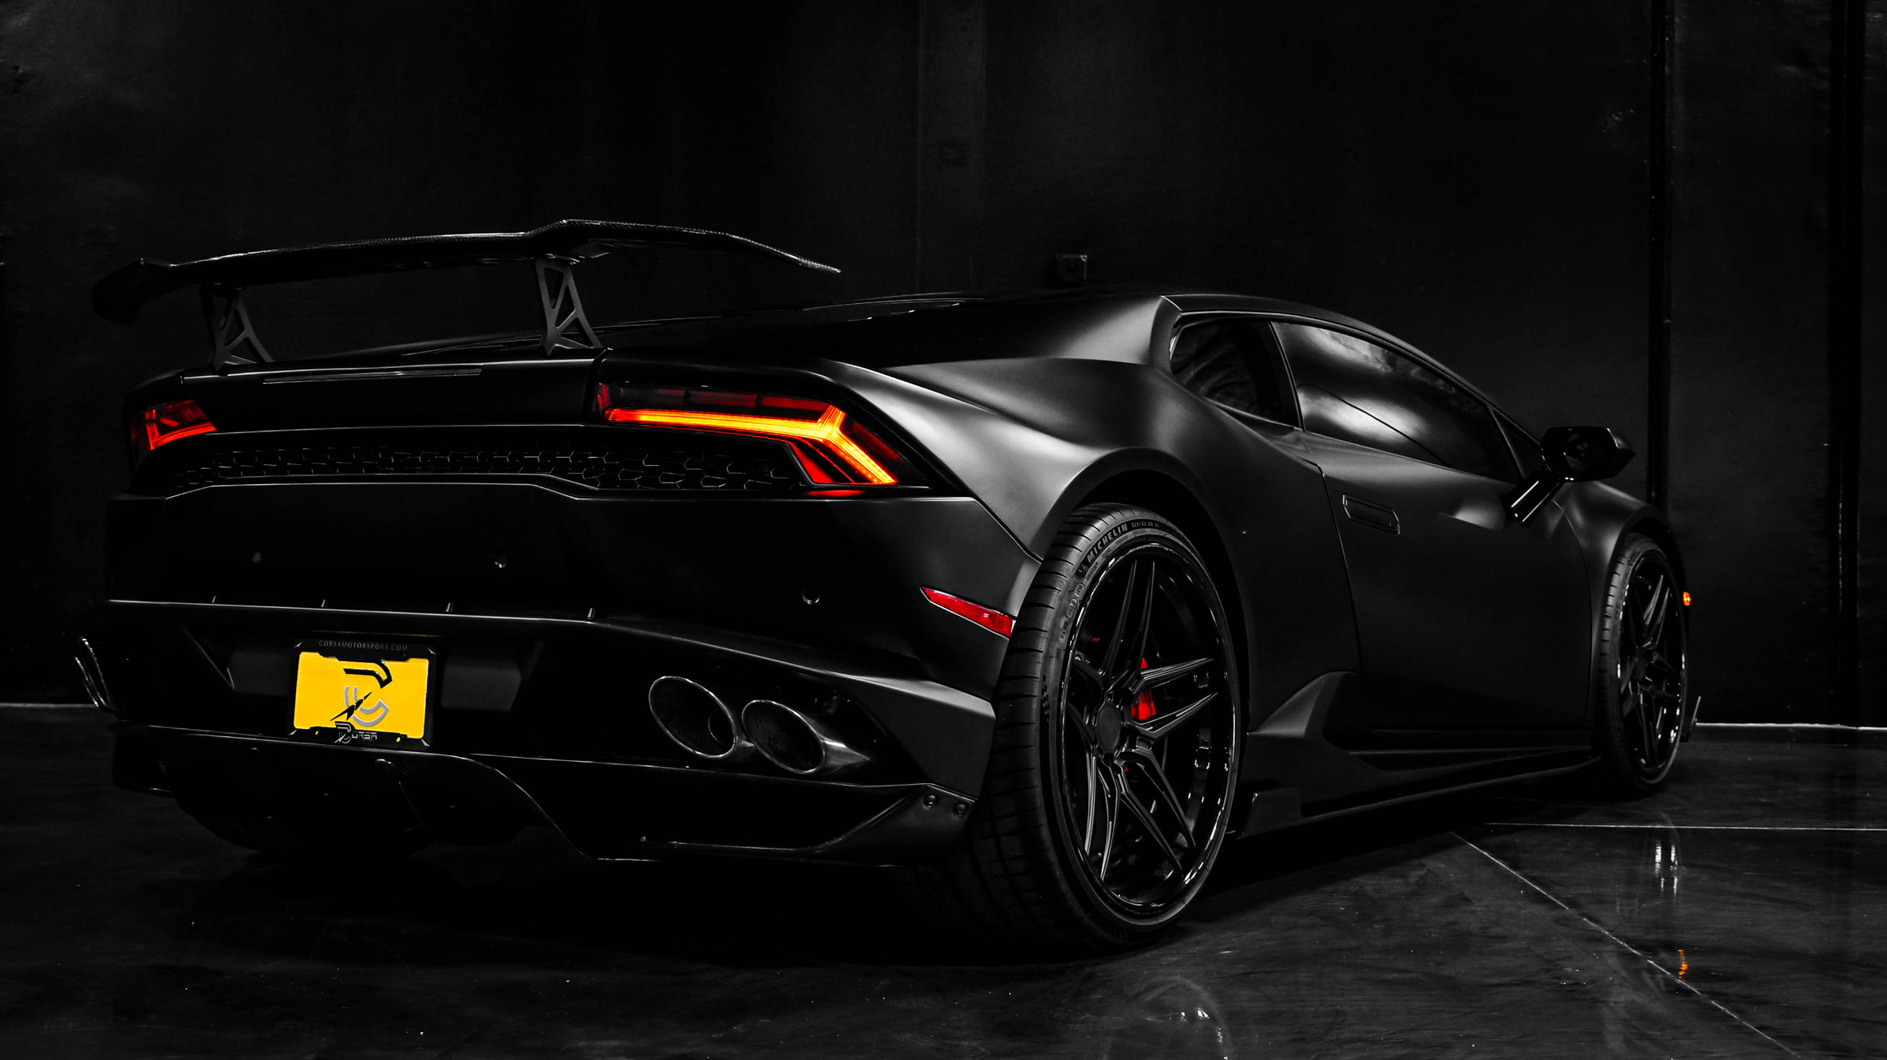
BORCELLE
Home
About
Contact
TARGET AUDIENCE
PRIMARY USERS OF THE WEBSITE
Car Enthusiasts
Individuals who love cars and motorsports, and enjoy owning miniature versions of their favorite vehicles.
Gift Shoppers
Friends or family members looking for unique gifts for car lovers, especially around holidays or birthdays.
Young Hobbyists / Students
Young users starting to collect models or researching car history for projects or fun.
Slide
5

Slide 6
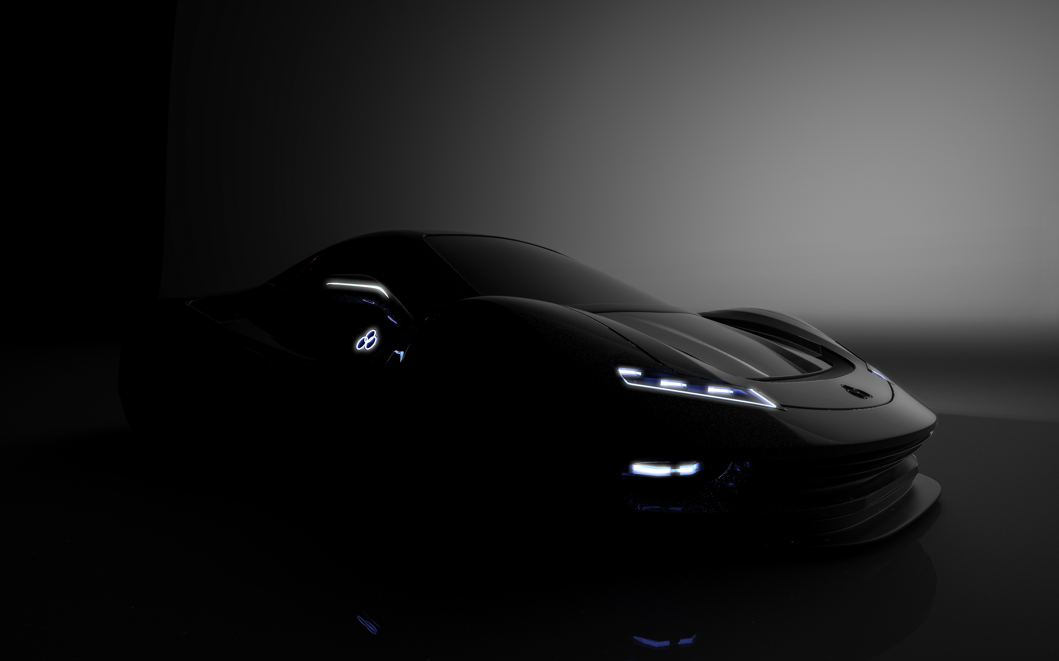
BORCELLE
Home
About
Contact
WHO THE WEBSITE WE DESIGNED FOR
Users looking for a simple and easy-to-use online shopping experience.
Collectors who want to browse models, check prices, and order quickly.
WHAT NEEDS DOES IT FULFILL
Easy Product Browsing
Customers can explore different model cars without confusion.
Order Management
The admin page gives the seller an instant view of what’s been ordered.
Slide
6

Slide 7
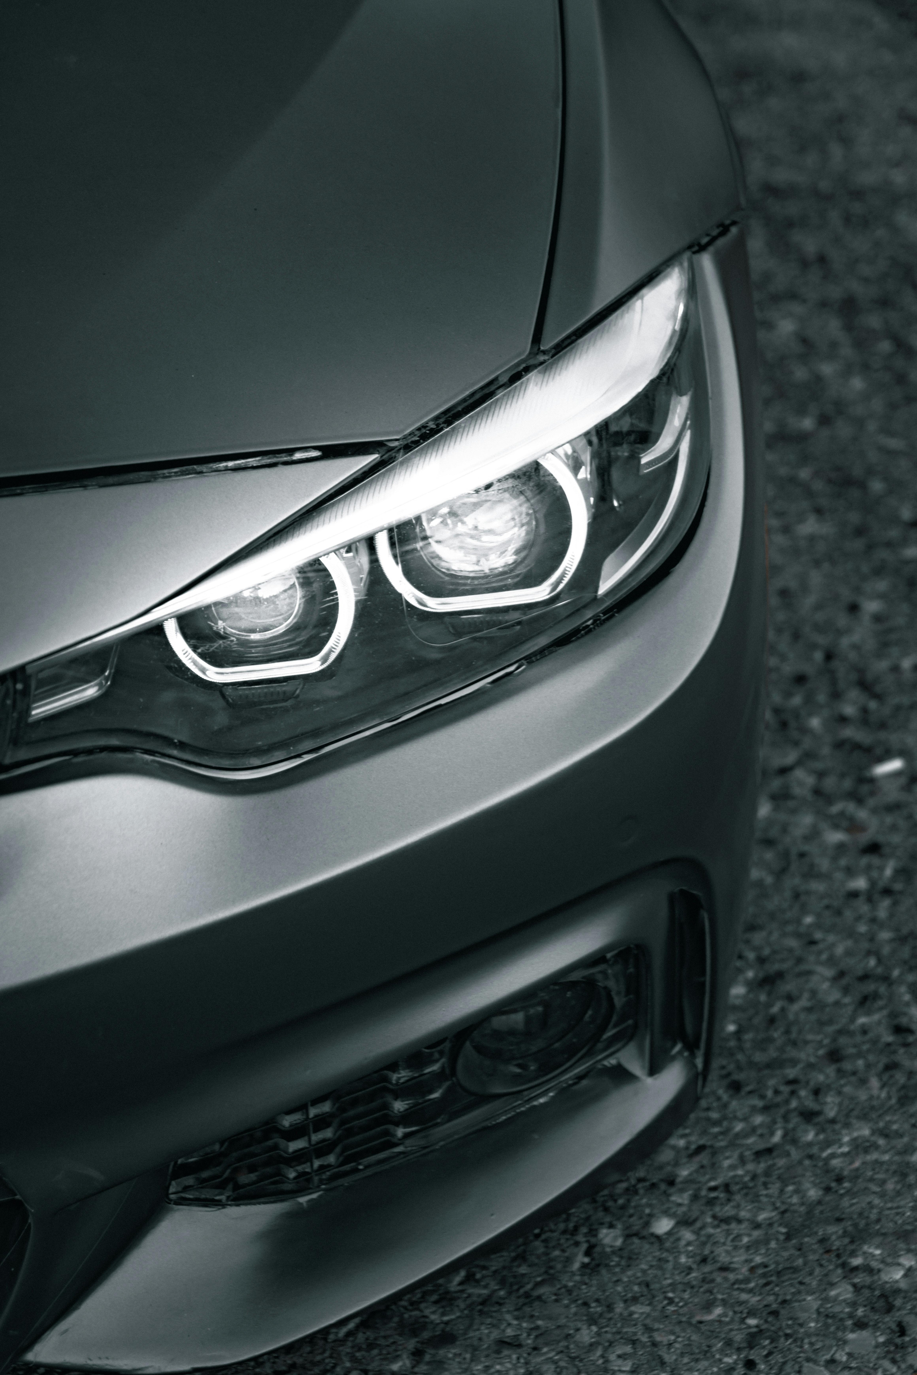
BORCELLE
Home
About
Contact
TOOLS AND TECHNOLOGIES USED
HTML (HyperText Markup Language)
Used to create the structure and content of the web pages — such as headings, product listings, buttons, and forms.
CSS (Cascading Style Sheets)
Used to style the website — including layout, colors, fonts, spacing, and visual design to make the site look clean and attractive.
DEVELOPMENT TOOL
Visual Studio Code (VS Code)
The main code editor used to build and organize HTML, CSS.
Slide
7

Slide 8
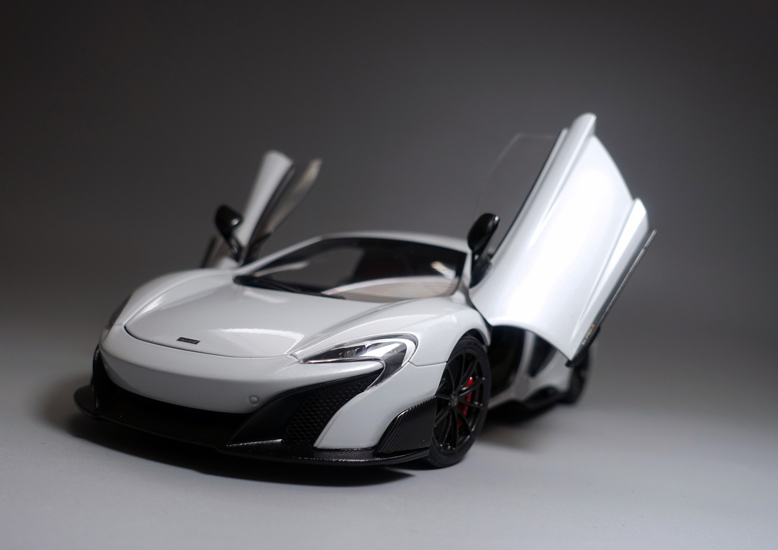
BORCELLE
Home
About
Contact
KEY FEATURES
1. Simple Online Shopping Experience
Users can easily browse and select model cars.
Products are displayed clearly with names and images.
2. Checkout Popup Form
When users click the "Checkout" button, a popup appears instead of redirecting them to another page.
The form collects name, age, and address quickly and efficiently.
Slide
8

Slide 9
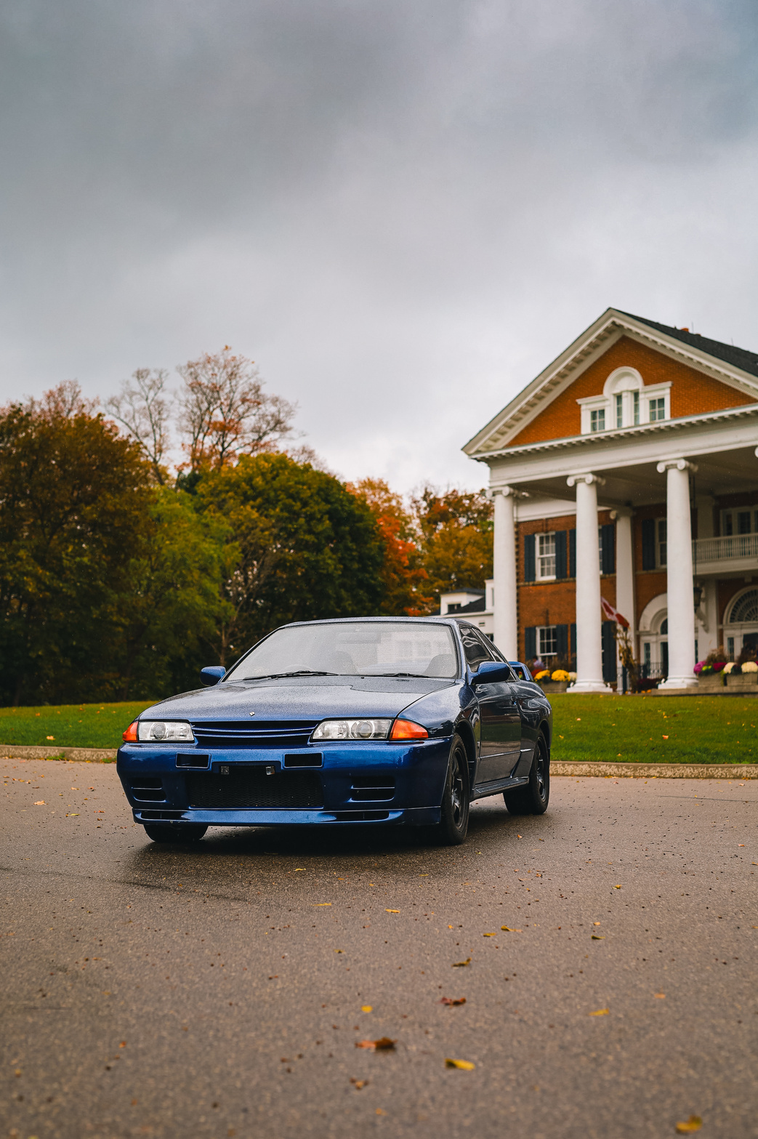
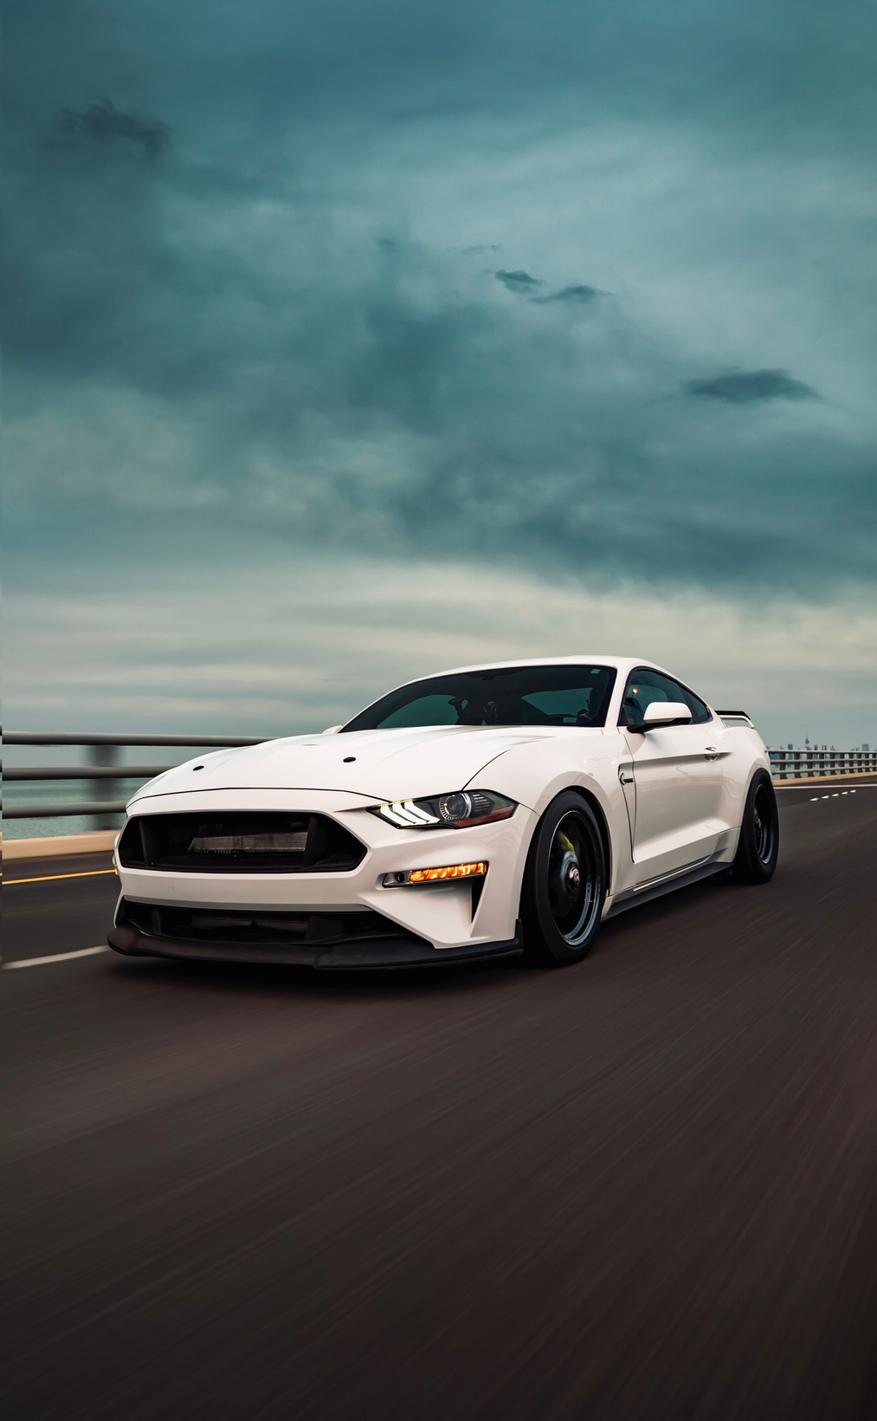
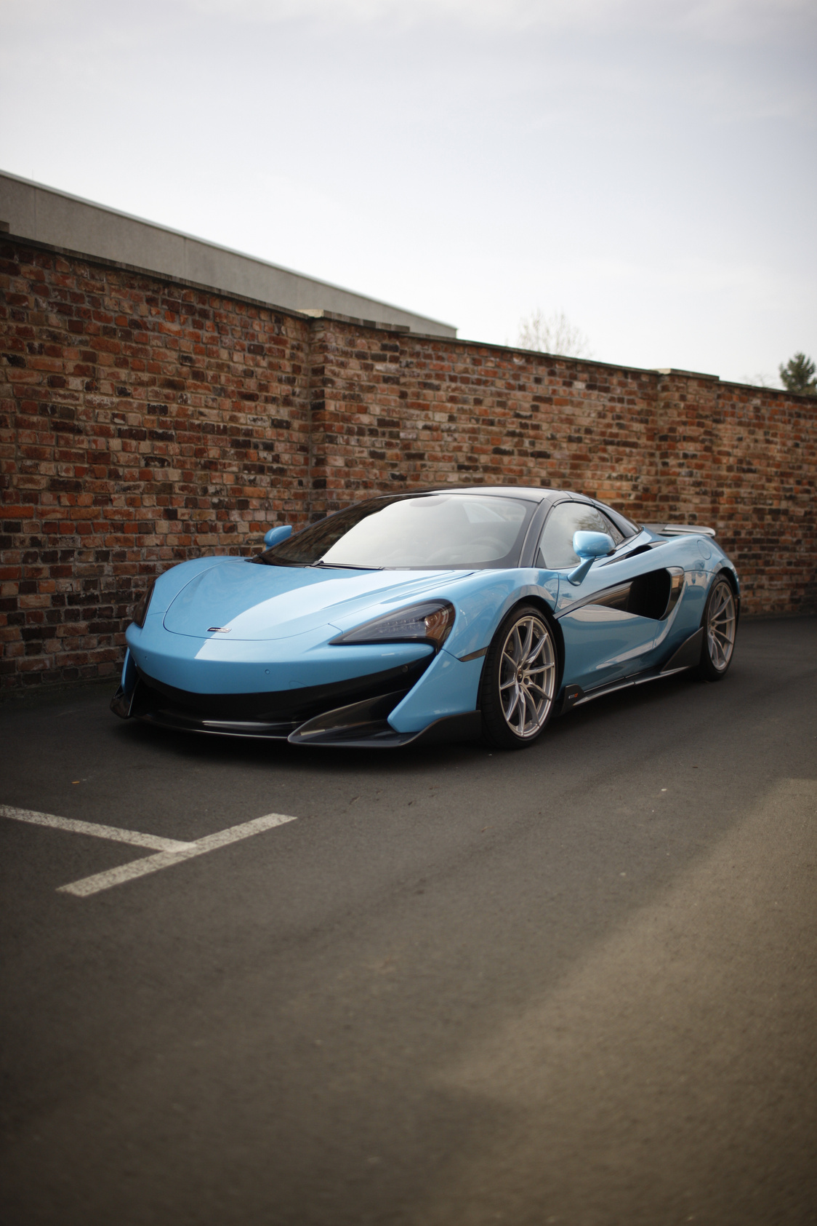
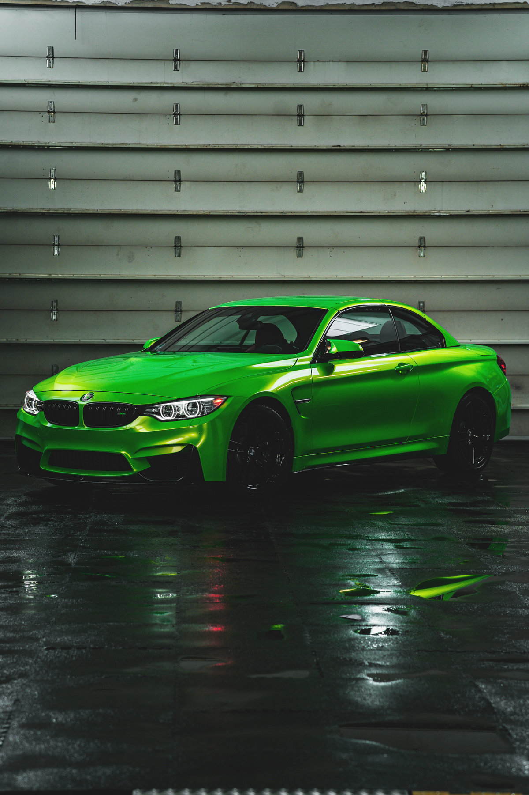
BORCELLE
Home
About
Contact
ENCHANCEMENTS
NO. 1
NO. 2
Admin Login System
Add a secure login feature to protect the admin page.
This ensures only
authorized users can view or
manage order data.
Admin Login System
Add a secure login feature to protect the admin page.
This ensures only authorized users can view or manage
order data.
Slide
9

Slide 10
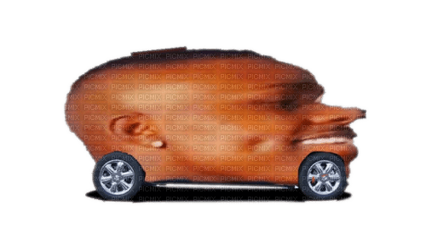
BORCELLE
Home
About
Contact
THANK YOU
Learn More
Play Video
2025 Presentation
Slide
12

